Slide 1
Security of Information Assets
By Vinod Sencha
Core Faculty(IS), RTI Jaipur

Slide 2
Learning Objectives
Security threats to
  data
  hardware and
  users,
common types of hacking,
protective measures
Slide <number>
Notes:
Learning Objectives:
Upon completion of this chapter, you should be able to:
Understand the need for information security.
Understand a successful information security program is the responsibility of an organization’s general management and IT management.
Understand the threats posed to information security and the more common attacks associated with those threats.
Differentiate threats to information systems from attacks against information systems.

Slide 3
IT Security
IT security is the protection of computer systems and networks from information disclosure, theft of or damage to their hardware, software, or electronic data, as well as from the disruption or misdirection of the services they provide.
IT security performs four important functions for an organization:
  Protects the organization’s ability to function
  Enables the safe operation of applications implemented on the organization’s IT systems
  Protects the data the organization collects and uses
  Safeguards the technology assets in use at the organization
Slide <number>
Notes:
INTRODUCTION
Information security is unlike any other aspect of information technology. It is an arena where the primary mission is to ensure things stay the way they are.
If there were no threats to information and systems, we could focus on improving systems that support the information, resulting in vast improvements in ease of use and usefulness.
The first phase, Investigation, provides an overview of the environment in which security must operate, and the problems that security must address.
BUSINESS NEEDS FIRST, TECHNOLOGY NEEDS LAST
Information security performs four important functions for an organization:
1. Protects the organization’s ability to function
2. Enables the safe operation of applications implemented on the organization’s IT systems
3. Protects the data the organization collects and uses
4. Safeguards the technology assets in use at the organization

Slide 4
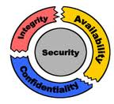
IT Security: Features
Confidentiality:-
Assurance that information is shared only among authorized persons or organizations.
Integrity:-
Assurance that the information is authentic and complete.
Maintaining and assuring the accuracy and consistency of data over its entire life-cycle.
Availability:-
Assurance that the systems responsible for delivering, storing and processing information are accessible when needed, by those who need them.
Slide <number>
Notes:
INTRODUCTION
Information security is unlike any other aspect of information technology. It is an arena where the primary mission is to ensure things stay the way they are.
If there were no threats to information and systems, we could focus on improving systems that support the information, resulting in vast improvements in ease of use and usefulness.
The first phase, Investigation, provides an overview of the environment in which security must operate, and the problems that security must address.
BUSINESS NEEDS FIRST, TECHNOLOGY NEEDS LAST
Information security performs four important functions for an organization:
1. Protects the organization’s ability to function
2. Enables the safe operation of applications implemented on the organization’s IT systems
3. Protects the data the organization collects and uses
4. Safeguards the technology assets in use at the organization

Slide 5
Vulnerabilities
A vulnerability is a weakness which can be exploited by a threat actor, such as an attacker, to cross privilege boundaries (i.e. perform unauthorized actions) within a computer system.
Vulnerabilities are classified according to the asset class they are related to:-
  Hardware:- Susceptibility to humidity/dust ; Unprotected storage; Over-heating.
  Software:- Insufficient testing; insecure coding; lack of audit trail; Design flaw.
  Network:- Unprotected communication lines; Insecure network architecture.
  Personnel:- Inadequate recruiting process; Inadequate security awareness; insider threat
  Physical site:- Area subject to natural disasters (e.g. flood, earthquake); interruption to power source
  Organizational:- Lack of regular audits; lack of continuity plans;
Slide <number>
Notes:
THREATS TO INFORMATION SECURITY
To make sound decisions about information security, create policies, and enforce them, management must be informed of the various kinds of threats facing the organization, its applications, data and information systems.
A threat is an object, person, or other entity that represents a constant danger to an asset.
To better understand the numerous threats facing the organization, a categorization scheme has been developed allowing us to group threats by their respective activities.
By examining each threat category in turn, management can most effectively protect its information through policy, education and training, and technology controls.

Slide 6
Threats
A threat is a potential negative action or event facilitated by a vulnerability that results in an unwanted impact to a computer system or application.
Any circumstance or event with the potential to adversely impact an IS through unauthorized access, destruction, disclosure, modification of data, and/or denial of service.
A countermeasure is any step you take to ward off a threat to protect user, data, or computer from harm.
Various Security threats:-
    Users:- Identity Theft; Loss of Privacy; Exposure to Spam; Physical Injuries.
    Hardware:- Power-related problems; theft; vandalism; and natural disasters.
    Data:- Malwares; Hacking; Cybercrime; and Cyber-terrorism.
Slide <number>
Notes:
THREATS TO INFORMATION SECURITY
To make sound decisions about information security, create policies, and enforce them, management must be informed of the various kinds of threats facing the organization, its applications, data and information systems.
A threat is an object, person, or other entity that represents a constant danger to an asset.
To better understand the numerous threats facing the organization, a categorization scheme has been developed allowing us to group threats by their respective activities.
By examining each threat category in turn, management can most effectively protect its information through policy, education and training, and technology controls.

Slide 7
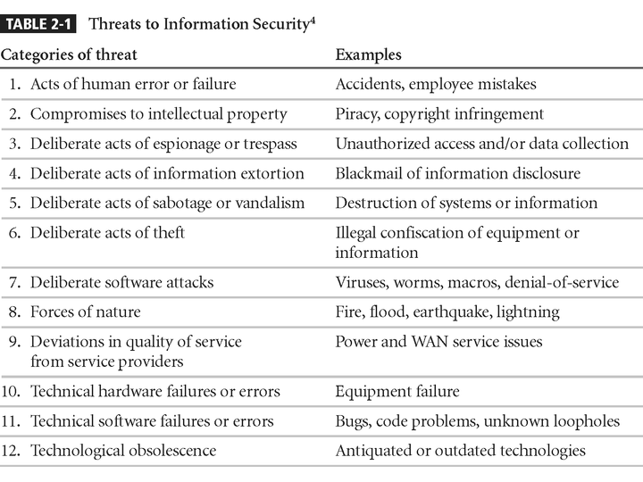
Threats to Information Security
Slide <number>
Notes:
1. Potential Acts of Human Error or Failure
2. Compromises to Intellectual Property
3. Deliberate Acts of Espionage or Trespass
4. Deliberate Acts of Information Extortion
5. Deliberate Acts of Sabotage or Vandalism
6. Deliberate Acts of Theft
7. Deliberate Software Attacks
8. Forces of Nature
9. Potential Deviations in Quality of Service from Service Providers
10. Technical Hardware Failures or Errors
11. Technical Software Failures or Errors
12. Technological Obsolescence

Slide 8
Threats(Keywords)
  Spam:-Unsolicited commercial e-mail/Junk e-mail
  Cookie:- Small text file that a Web server put on computer
  Web Bugs:-a small gif embedded in webpage/email
  Malwares:-Malicious Software
    Virus(require Some executables), Worms(Self executables), Spyware, Trojan Horses, Botnet (Robot Network)
  Shoulder Surfing
  Hacking:-
    Sniffing:- finding user’s password(Password Sharing, Password Guessing or Password Capture
    Social Engineering:- Dumpster Diving, Phishing(Email) & Vishing(Phone Calls)
    Spoofing
  DDoS:-Distributed Denial of Services.
  Cybercrime; and Cyber-terrorism.
Slide <number>
Notes:
THREATS TO INFORMATION SECURITY
To make sound decisions about information security, create policies, and enforce them, management must be informed of the various kinds of threats facing the organization, its applications, data and information systems.
A threat is an object, person, or other entity that represents a constant danger to an asset.
To better understand the numerous threats facing the organization, a categorization scheme has been developed allowing us to group threats by their respective activities.
By examining each threat category in turn, management can most effectively protect its information through policy, education and training, and technology controls.

Slide 9
Attack Descriptions
Denial-of-service (DoS) –
  attacker sends a large number of connection or information requests to a target
  so many requests are made that the target system cannot handle them successfully along with other, legitimate requests for service
  may result in a system crash, or merely an inability to perform ordinary functions
Distributed Denial-of-service (DDoS) - an attack in which a coordinated stream of requests is launched against a target from many locations at the same time
Slide <number>
Notes:
Attack Descriptions
Denial-of-service (DoS) - the attacker sends a large number of connection or information requests to a target. So many requests are made that the target system cannot handle them successfully along with other, legitimate requests for service. This may result in a system crash, or merely an inability to perform ordinary functions.
Distributed Denial-of-service (DDoS) - an attack in which a coordinated stream of requests is launched against a target from many locations at the same time.

Slide 10
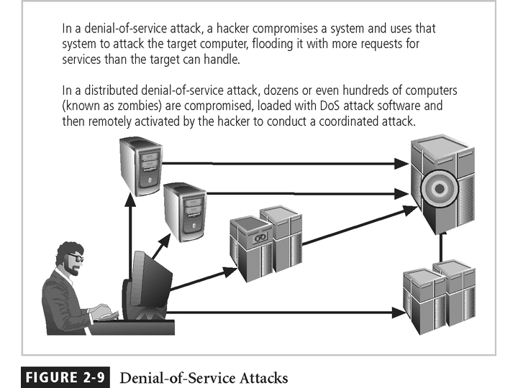
Slide <number>

Slide 11
Attack Descriptions
Spoofing - technique used to gain unauthorized access whereby the intruder sends messages to a computer with an IP address indicating that the message is coming from a trusted host
Man-in-the-Middle - an attacker sniffs packets from the network, modifies them, and inserts them back into the network
Slide <number>
Notes:
Attack Descriptions
Spoofing - a technique used to gain unauthorized access to computers, whereby the intruder sends messages to a computer with an IP address indicating that the message is coming from a trusted host.
Man-in-the-Middle - In the man-in-the-middle or TCP hijacking attack, an attacker sniffs packets from the network, modifies them, and inserts them back into the network.
Spam - unsolicited commercial e-mail. While many consider Spam a nuisance rather than an attack, it is emerging as a vector for some attacks.

Slide 12
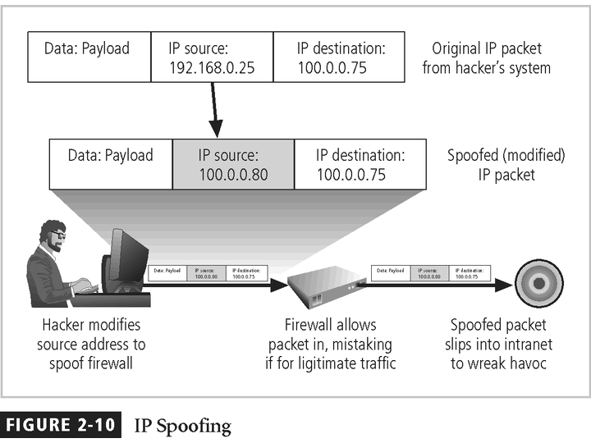
Slide <number>

Slide 13
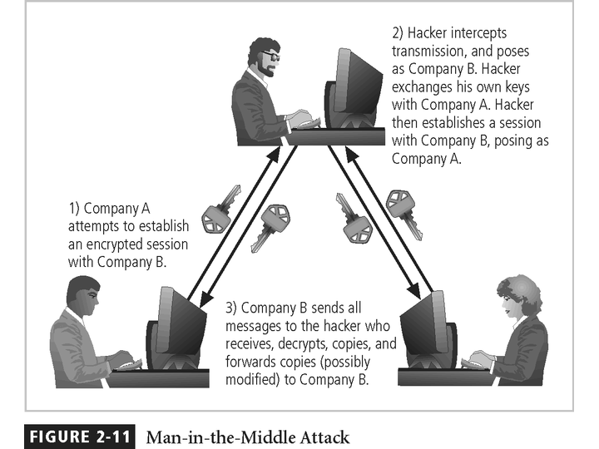
Slide <number>

Slide 14
Attack Descriptions
A phishing- an online threat that appears to be from a legitimate user or business, tricking users into providing sensitive information such as a username and password, downloading or opening an application, or transferring money.
Whaling-targets a high-profile business executive or manager with more critical information to lose, using emails and web pages which serve the scam to appear as official.
Slide <number>
Notes:
Attack Descriptions
Spoofing - a technique used to gain unauthorized access to computers, whereby the intruder sends messages to a computer with an IP address indicating that the message is coming from a trusted host.
Man-in-the-Middle - In the man-in-the-middle or TCP hijacking attack, an attacker sniffs packets from the network, modifies them, and inserts them back into the network.
Spam - unsolicited commercial e-mail. While many consider Spam a nuisance rather than an attack, it is emerging as a vector for some attacks.

Slide 15
Attack Descriptions
Vishing- the combination of voice and phishing, taking place over the phone, where the threat actors are able to use tools specific to VoIP systems, thereby hacking their auto dialers to send robo messages from a spoofed VoIP address.
Smishing- uses SMS text messages to mislead its victims into providing sensitive information to a threat actor.
Slide <number>
Notes:
Attack Descriptions
Spoofing - a technique used to gain unauthorized access to computers, whereby the intruder sends messages to a computer with an IP address indicating that the message is coming from a trusted host.
Man-in-the-Middle - In the man-in-the-middle or TCP hijacking attack, an attacker sniffs packets from the network, modifies them, and inserts them back into the network.
Spam - unsolicited commercial e-mail. While many consider Spam a nuisance rather than an attack, it is emerging as a vector for some attacks.

Slide 16
Attack Descriptions
Spam- mass emails sent to a large number of users, and they are sometimes annoying solicitations or they can be scams or hoaxes.
Pharming-social engineering attack that misdirects a user’s website’s traffic to a fake site, using code on the computer that modifies the destination URL to the attacker’s. Pharming can result in the loss of data, credit card information, or lead to identity loss.
Slide <number>
Notes:
Attack Descriptions
Spoofing - a technique used to gain unauthorized access to computers, whereby the intruder sends messages to a computer with an IP address indicating that the message is coming from a trusted host.
Man-in-the-Middle - In the man-in-the-middle or TCP hijacking attack, an attacker sniffs packets from the network, modifies them, and inserts them back into the network.
Spam - unsolicited commercial e-mail. While many consider Spam a nuisance rather than an attack, it is emerging as a vector for some attacks.

Slide 17
Attack Descriptions
Spam- mass emails sent to a large number of users, and they are sometimes annoying solicitations or they can be scams or hoaxes.
Pharming-social engineering attack that misdirects a user’s website’s traffic to a fake site, using code on the computer that modifies the destination URL to the attacker’s. Pharming can result in the loss of data, credit card information, or lead to identity loss.
Slide <number>
Notes:
Attack Descriptions
Spoofing - a technique used to gain unauthorized access to computers, whereby the intruder sends messages to a computer with an IP address indicating that the message is coming from a trusted host.
Man-in-the-Middle - In the man-in-the-middle or TCP hijacking attack, an attacker sniffs packets from the network, modifies them, and inserts them back into the network.
Spam - unsolicited commercial e-mail. While many consider Spam a nuisance rather than an attack, it is emerging as a vector for some attacks.

Slide 18
Attack Descriptions
Tailgating-a simpler type of social engineering attack where the threat actor gains physical access to a facility by following a user through a security check point.
Shoulder surfing-is a type of social engineering that refers to obtaining private information through direct observation via casual glance over the shoulder of employee to view their monitor.
Slide <number>
Notes:
Attack Descriptions
Spoofing - a technique used to gain unauthorized access to computers, whereby the intruder sends messages to a computer with an IP address indicating that the message is coming from a trusted host.
Man-in-the-Middle - In the man-in-the-middle or TCP hijacking attack, an attacker sniffs packets from the network, modifies them, and inserts them back into the network.
Spam - unsolicited commercial e-mail. While many consider Spam a nuisance rather than an attack, it is emerging as a vector for some attacks.

Slide 19
Attack Descriptions
Tailgating-a simpler type of social engineering attack where the threat actor gains physical access to a facility by following a user through a security check point.
Shoulder surfing-is a type of social engineering that refers to obtaining private information through direct observation via casual glance over the shoulder of employee to view their monitor.
Slide <number>
Notes:
Attack Descriptions
Spoofing - a technique used to gain unauthorized access to computers, whereby the intruder sends messages to a computer with an IP address indicating that the message is coming from a trusted host.
Man-in-the-Middle - In the man-in-the-middle or TCP hijacking attack, an attacker sniffs packets from the network, modifies them, and inserts them back into the network.
Spam - unsolicited commercial e-mail. While many consider Spam a nuisance rather than an attack, it is emerging as a vector for some attacks.

Slide 20
Attack Descriptions
Session Hijacking- When an attacker gains access to a target’s computer to take over the internet session so as to take control of a user’s browsing session to gain access to their personal information and passwords
Slide <number>
Notes:
Attack Descriptions
Spoofing - a technique used to gain unauthorized access to computers, whereby the intruder sends messages to a computer with an IP address indicating that the message is coming from a trusted host.
Man-in-the-Middle - In the man-in-the-middle or TCP hijacking attack, an attacker sniffs packets from the network, modifies them, and inserts them back into the network.
Spam - unsolicited commercial e-mail. While many consider Spam a nuisance rather than an attack, it is emerging as a vector for some attacks.

Slide 21
Protective Measures
Bolster Access Control
  by using a strong password system. You should have a mix of uppercase and lower case letters, numbers, and special characters.
  Also, always reset all default passwords.
  Finally, create a strong access control policy.
2. Keep All Software Updated
  From anti-virus software to computer operating systems, ensure your software is updated.
  When a new version of software is released, the version usually includes fixes for security vulnerabilities.
  Manual software updates can be time-consuming. Use automatic software updates for as many programs as possible.
Slide <number>

Slide 22
Protective Measures
3. Standardize Software
  Keep your systems protecting by standardizing software like Operating system, Browser, Media player, Plug-in.
  Ensure that users cannot install software onto the system without approval.
4. Use Network Protection Measures
  Install a firewall
  Ensure proper access controls
  Use IDS/IPS to track potential packet floods
  Use network segmentation
  Use a virtual private network (VPN)
  Conduct proper maintenance
Slide <number>

Slide 23
Protective Measures
5. Employee Training
  Sometimes external threats are successful because of an insider threat. The weakest link in data protection can be your own employees.
  Ensure your employees understand network security.
  Employees should be able to identify threats.
  They should also know who to contact to avoid a security breach
6. Schedule backups
  You can schedule backups to external hard drives or in the cloud in order to keep your data stored safely.
  The right frequency is weekly but you can do incremental backups every few days.
Slide <number>

Slide 24

Acts of Human Error or Failure
Includes acts done without malicious intent
Caused by:
  Inexperience
  Improper training
  Incorrect assumptions
  Other circumstances
Employees are greatest threats to information security – They are closest to the organizational data
Slide <number>
Notes:
Potential Acts of Human Error or Failure
This category includes the possibility of acts performed without intent or malicious purpose by an individual who is an employee of an organization.
Inexperience, improper training, the making of incorrect assumptions, and other circumstances can cause problems.
Employees constitute one of the greatest threats to information security, as the individuals closest to the organizational data.
Employee mistakes can easily lead to the following: revelation of classified data, entry of erroneous data, accidental deletion or modification of data, storage of data in unprotected areas, and failure to protect information.
Many threats can be prevented with controls, ranging from simple procedures, such as requiring the user to type a critical command twice, to more complex procedures, such as the verification of commands by a second party.

Slide 25
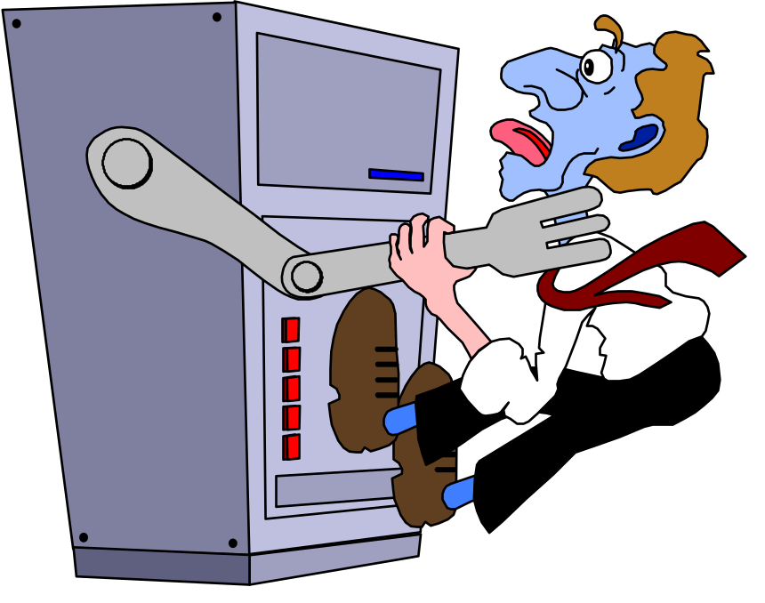
Acts of Human Error or Failure
Employee mistakes can easily lead to the following:
  revelation of classified data
  entry of erroneous data
  accidental deletion or modification of data
  storage of data in unprotected areas
  failure to protect information
Many of these threats can be prevented with controls
Slide <number>
Notes:
Potential Acts of Human Error or Failure
This category includes the possibility of acts performed without intent or malicious purpose by an individual who is an employee of an organization.
Inexperience, improper training, the making of incorrect assumptions, and other circumstances can cause problems.
Employees constitute one of the greatest threats to information security, as the individuals closest to the organizational data.
Employee mistakes can easily lead to the following: revelation of classified data, entry of erroneous data, accidental deletion or modification of data, storage of data in unprotected areas, and failure to protect information.
Many threats can be prevented with controls, ranging from simple procedures, such as requiring the user to type a critical command twice, to more complex procedures, such as the verification of commands by a second party.

Slide 26
Compromises to
Intellectual Property
Intellectual property is “the ownership of ideas and control over the tangible or virtual representation of those ideas”
Many organizations are in business to create intellectual property
  trade secrets
  copyrights
  trademarks
  patents
Slide <number>
Notes:
Compromises to Intellectual Property
Many organizations create or support the development of intellectual property as part of their business operations.
Intellectual property is defined as “the ownership of ideas and control over the tangible or virtual representation of those ideas.”
Intellectual property for an organization includes trade secrets, copyrights, trademarks, and patents.
Once intellectual property (IP) has been defined, and properly identified, breaches to IP constitute a threat to the security of this information.
Most common in IP breaches involve the unlawful use or duplication of software-based intellectual property, known as software piracy.
In addition to the laws surrounding software piracy, two watchdog organizations investigate allegations of software abuse: Software & Information Industry Association (SIIA) formerly the Software Publishers Association, and the Business Software Alliance (BSA).
Enforcement of copyright violations, piracy, and the like has been attempted through a number of technical security mechanisms, including digital watermarks, embedded codes.

Slide 27
Compromises to
Intellectual Property
Most common IP breaches involve software piracy
Watchdog organizations investigate:
  Software & Information Industry Association (SIIA)
  Business Software Alliance (BSA)
Enforcement of copyright has been attempted with technical security mechanisms
Slide <number>
Notes:
Compromises to Intellectual Property
Many organizations create or support the development of intellectual property as part of their business operations.
Intellectual property is defined as “the ownership of ideas and control over the tangible or virtual representation of those ideas.”
Intellectual property for an organization includes trade secrets, copyrights, trademarks, and patents.
Once intellectual property (IP) has been defined, and properly identified, breaches to IP constitute a threat to the security of this information.
Most common in IP breaches involve the unlawful use or duplication of software-based intellectual property, known as software piracy.
In addition to the laws surrounding software piracy, two watchdog organizations investigate allegations of software abuse: Software & Information Industry Association (SIIA) formerly the Software Publishers Association, and the Business Software Alliance (BSA).
Enforcement of copyright violations, piracy, and the like has been attempted through a number of technical security mechanisms, including digital watermarks, embedded codes.

Slide 28
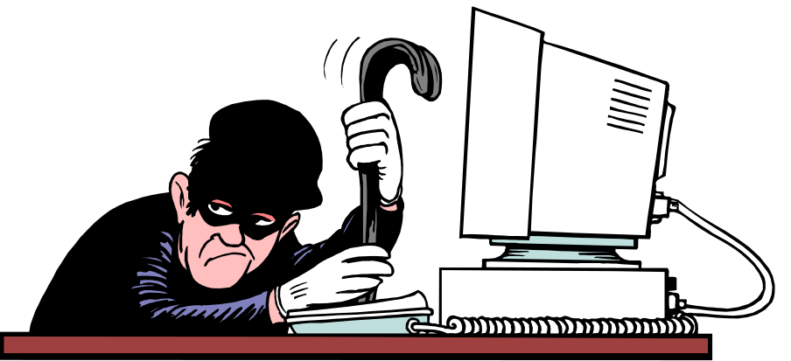
Espionage/Trespass
Broad category of activities that breach confidentiality
  Unauthorized accessing of information
  Competitive intelligence vs. espionage
  Shoulder surfing can occur any place a person is accessing confidential information
Controls implemented to mark the boundaries of an organization’s virtual territory giving notice to trespassers that they are encroaching on the organization’s cyberspace
Hackers uses skill, guile, or fraud to steal the property of someone else
Slide <number>
Notes:
Deliberate Acts of Espionage or Trespass
This threat represents a well-known and broad category of electronic and human activities that breach the confidentiality of information.
When an unauthorized individual gains access to the information an organization is trying to protect, that act is categorized as a deliberate act of espionage or trespass.
When information gatherers employ techniques that cross the threshold of what is legal and/or ethical, they enter the world of industrial espionage.
Instances of shoulder surfing occur at computer terminals, desks, ATM machines, public phones, or other places where a person is accessing confidential information.
Deliberate Acts of Espionage or Trespass
The threat of Trespass can lead to unauthorized, real or virtual actions that enable information gatherers to enter premises or systems they have not been authorized to enter.
Controls are sometimes implemented to mark the boundaries of an organization’s virtual territory.
These boundaries give notice to trespassers that they are encroaching on the organization’s cyberspace.
The classic perpetrator of deliberate acts of espionage or trespass is the hacker.
In the gritty world of reality, a hacker uses skill, guile, or fraud to attempt to bypass the controls placed around information that is the property of someone else. The hacker frequently spends long hours examining the types and structures of the targeted systems.

Slide 29
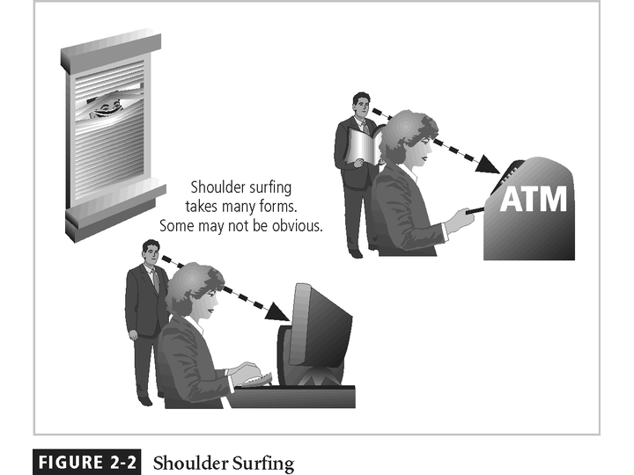
Slide <number>

Slide 30
Espionage/Trespass
Generally two skill levels among hackers:
  Expert hacker
    develops software scripts and codes exploits
    usually a master of many skills
    will often create attack software and share with others
  Script kiddies
    hackers of limited skill
    use expert-written software to exploit a system
    do not usually fully understand the systems they hack
Other terms for system rule breakers:
  Cracker - an individual who “cracks” or removes protection designed to prevent unauthorized duplication
  Phreaker - hacks the public telephone network
Slide <number>
Notes:
Deliberate Acts of Espionage or Trespass
There are generally two skill levels among hackers.
The first is the expert hacker, who develops software scripts and codes exploits used by the second category, the novice, or unskilled hacker.
The expert hacker is usually a master of several programming languages, networking protocols, and operating systems and also exhibits a mastery of the technical environment of the chosen targeted system.
However, expert hackers have now become bored with directly attacking systems, and have turned to writing software.
The software they are writing is automated exploits that allow novice hackers to become script kiddies, hackers of limited skill who use expert-written software to exploit a system, but do not fully understand or appreciate the systems they hack.
As a result of preparation and continued vigilance, attacks conducted by scripts are usually predictable, and can be adequately defended against.
There are other terms for system rule breakers :
The term cracker is now commonly associated with an individual who “cracks” or removes the software protection from an application designed to prevent unauthorized duplication.
A phreaker hacks the public telephone network to make free calls, disrupt services, and generally wreak havoc.

Slide 31
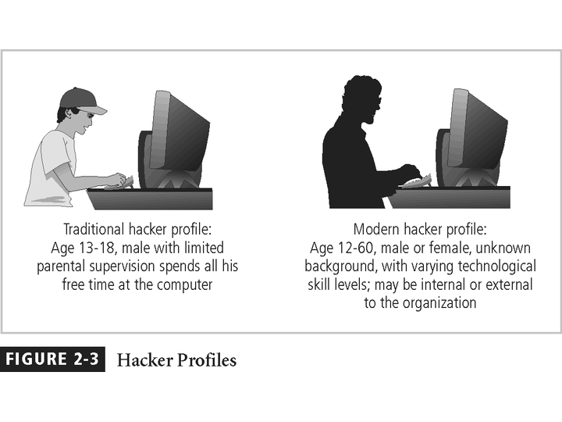
Slide <number>

Slide 32
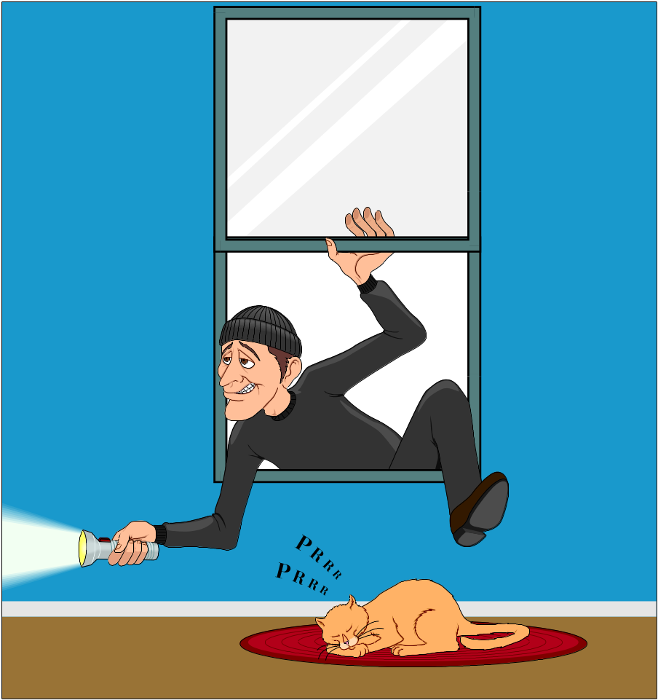
Information Extortion
Information extortion is an attacker or formerly trusted insider stealing information from a computer system and demanding compensation for its return or non-use
Extortion found in credit card number theft
Slide <number>
Notes:
Deliberate Acts of Information Extortion
The threat of information extortion is the possibility of an attacker or formerly trusted insider stealing information from a computer system and demanding compensation for its return or for an agreement to not disclose the information.
Extortion is common in credit card number theft.

Slide 33
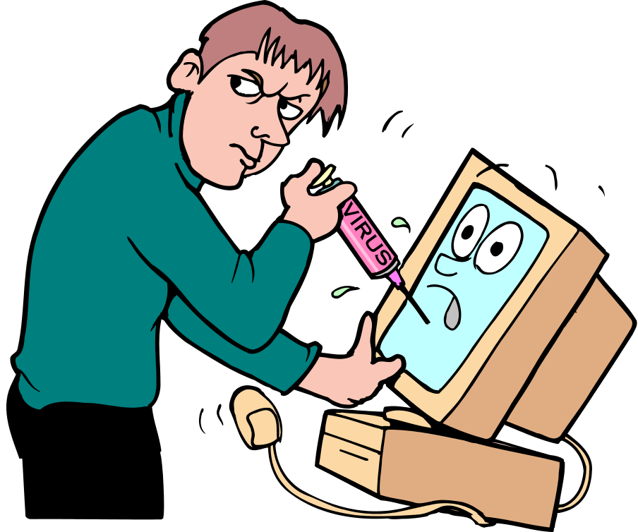
Sabotage or Vandalism
Individual or group who want to deliberately sabotage the operations of a computer system or business, or perform acts of vandalism to either destroy an asset or damage the image of the organization
These threats can range from petty vandalism to organized sabotage
Organizations rely on image so Web defacing can lead to dropping consumer confidence and sales
Rising threat of hacktivist or cyber-activist operations – the most extreme version is cyber-terrorism
Slide <number>
Notes:
Deliberate Acts of Sabotage or Vandalism
Equally popular today is the assault on the electronic face of an organization, its Web site.
This category of threat addresses the individual or group of individuals who want to deliberately sabotage the operations of a computer system or business, or perform acts of vandalism to either destroy an asset or damage the image of the organization.
These threats can range from petty vandalism by employees to organized sabotage against an organization.
Organizations frequently rely on image to support the generation of revenue, so if an organization’s Web site is defaced, a drop in consumer confidence is probable, reducing the organization’s sales and net worth.
Compared to Website defacement, vandalism within a network is more malicious in intent and less public.
Today, security experts are noticing a rise in another form of online vandalism in what are described as hacktivist or cyber-activist operations. A more extreme version is referred to as cyber-terrorism.

Slide 34
Deliberate Acts of Theft
Illegal taking of another’s property - physical, electronic, or intellectual
The value of information suffers when it is copied and taken away without the owner’s knowledge
Physical theft can be controlled - a wide variety of measures used from locked doors to guards or alarm systems
Electronic theft is a more complex problem to manage and control - organizations may not even know it has occurred
Slide <number>
Notes:
Deliberate Acts of Theft
Theft is the illegal taking of another’s property. Within an organization, that property can be physical, electronic, or intellectual.
The value of information suffers when it is copied and taken away without the owner’s knowledge.
Physical theft can be controlled quite easily. A wide variety of measures can be used from simple locked doors, to trained security personnel, and the installation of alarm systems.
Electronic theft, however, is a more complex problem to manage and control. Organizations may not even know it has occurred.

Slide 35
Internet Service Issues
Loss of Internet service can lead to considerable loss in the availability of information
  organizations have sales staff and telecommuters working at remote locations
When an organization outsources its web servers, the outsourcer assumes responsibility for
  All Internet Services
  The hardware and operating system software used to operate the web site
Slide <number>
Notes:
Internet Service Issues
For organizations that rely heavily on the Internet and the Web to support continued operations, the threat of the potential loss of Internet service can lead to considerable loss in the availability of information.
Many organizations have sales staff and telecommuters working at remote locations.
When an organization places its web servers in the care of a Web Hosting provider, that outsourcer assumes responsibility for all Internet Services as well as for the hardware and operating system software used to operate the web site.

Slide 36
Communications and Other Services
Other utility services have potential impact
Among these are
  telephone
  water & wastewater
  trash pickup
  cable television
  natural or propane gas
  custodial services
The threat of loss of services can lead to inability to function properly
Slide <number>
Notes:
Communications and other Service Provider Issues
Other utility services can impact organizations as well.
Among these are telephone, water, wastewater, trash pickup, cable television, natural, or propane gas, and custodial services.
The threat of loss of these services can lead to the inability of an organization to function properly.

Slide 37
Power Irregularities
Voltage levels can increase, decrease, or cease:
  spike – momentary increase
  surge – prolonged increase
  sag – momentary low voltage
  brownout – prolonged drop
  fault – momentary loss of power
  blackout – prolonged loss
Electronic equipment is susceptible to fluctuations, controls can be applied to manage power quality
Slide <number>
Notes:
Power Irregularities
The threat of irregularities from power utilities are common and can lead to fluctuations such as power excesses, power shortages, and power losses.
In the U.S., buildings are “fed” 120-volt, 60-cycle power usually through 15 and 20 amp circuits.
Voltage levels can:
spike – momentary increase or surge – prolonged increase;
sag – momentary low voltage, or brownout – prolonged drop;
fault – momentary loss of power, or blackout – prolonged loss;
Since sensitive electronic equipment, especially networking equipment, computers, and computer-based systems are susceptible to fluctuations, controls can be applied to manage power quality.

Slide 38
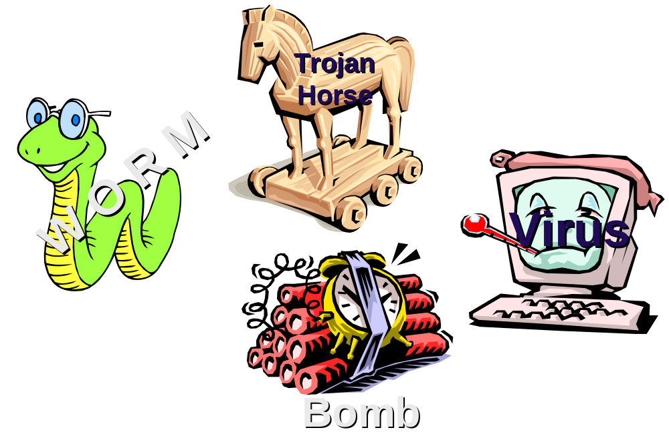
Deliberate Software Attacks
When an individual or group designs software to attack systems, they create malicious code/software called malware
  Designed to damage, destroy, or deny service to the target systems
Includes:
  macro virus
  boot virus
  worms
  Trojan horses
  logic bombs
  back door or trap door
  denial-of-service attacks
  polymorphic
  hoaxes
Slide <number>
Notes:
Deliberate Software Attacks
Deliberate software attacks occur when an individual or group designs software to attack an unsuspecting system. Most of this software is referred to as malicious code or malicious software, or sometimes malware.
These software components or programs are designed to damage, destroy, or deny service to the target systems.
Some of the more common instances of malicious code are viruses and worms, Trojan horses, logic-bombs, back doors, and denial-of-services attacks.
Computer viruses are segments of code that perform malicious actions.
This code behaves very much like a virus pathogen attacking animals and plants, using the cell’s own replication machinery to propagate and attack.
The code attaches itself to the existing program and takes control of that program’s access to the targeted computer.
The virus-controlled target program then carries out the virus’s plan, by replicating itself into additional targeted systems.
The macro virus is embedded in the automatically executing macro code, common in office productivity software like word processors, spread sheets, and database applications.
The boot virus, infects the key operating systems files located in a computer’s boot sector.
Worms - malicious programs that replicate themselves constantly without requiring another program to provide a safe environment for replication. Worms can continue replicating themselves until they completely fill available resources, such as memory, hard drive space, and network bandwidth.
Trojan horses - software programs that hide their true nature, and reveal their designed behavior only when activated. Trojan horses are frequently disguised as helpful, interesting or necessary pieces of software, such as readme.exe files often included with shareware or freeware packages.
Back door or Trap door - A virus or worm can have a payload that installs a back door or trap door component in a system. This allows the attacker to access the system at will with special privileges.
Polymorphism - A threat that changes its apparent shape over time, representing a new threat not detectable by techniques that are looking for a pre-configured signature. These threats actually evolve variations in size and appearance to elude detection by anti-virus software programs, making detection more of a challenge.
Virus and Worm Hoaxes - As frustrating as viruses and worms are, perhaps more time and money is spent on resolving virus hoaxes. Well-meaning people spread the viruses and worms when they send e-mails warning of fictitious or virus laden threats.

Slide 39
Deliberate Software Attacks
Virus is a computer program that attaches itself to an executable file or application.
It can replicate itself, usually through an executable program attached to an e-mail.
The keyword is “attaches”. A virus can not stand on its own.
You must prevent viruses from being installed on computers in your organizations.
Slide <number>
Notes:
Virus is a computer program that attaches itself to an executable file or application. It can replicate itself, usually through an executable program attached to an e-mail.
The keyword is “attaches”. A virus can not stand on its own. It cannot replicate itself or operate without the presence of a host program. A virus attaches itself to a host program, just as the flu attaches itself to a host organism. You must prevent viruses from being installed on computers in your organizations, otherwise, after the virus attaches itself to a program, such as microsoft Word, it performs whatever its creator designed it to do.

Slide 40
Deliberate Software Attacks
There is no foolproof method of preventing them from attaching themselves to your computer
Antivirus software compares virus signature files against the programming code of know viruses.
Regularly update virus signature files is crucial.
Slide <number>
Notes:
For example, with Norton Antivirus Enterprise Edition, administrators can configure a server that’s responsible for pushing new antivirus update to client computers in an organization.

Slide 41
Deliberate Software Attacks
A worm is a computer program that replicates and propagates itself without having to attach itself to a host.
Most infamous worms are Code Red and Nimda.
Cost businesses millions of dollars in damage as a result of lost productivity
Computer downtime and the time spent recovering lost data, reinstalling programming's, operating systems, and hiring or contracting IT personnel.
Slide <number>

Slide 42
Deliberate Software Attacks
Trojan Programs disguise themselves as useful computer programs or applications and can install a backdoor or rootkit on a computer.
Backdoors or rootkits are computer programs that give attackers a means of regaining access to the attacked computer later.
Slide <number>
Notes:
A rootkit is created after an attack and usually hides itself within the OS tools, so it’s almost impossible to detect.

Slide 43
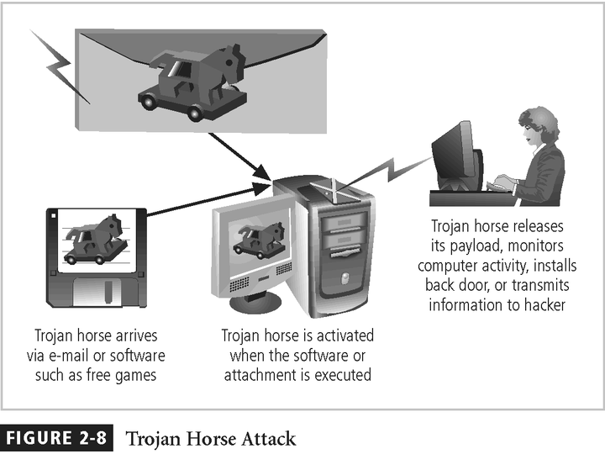
Slide <number>

Slide 44
Deliberate Software Attacks
Challenges:
  Trojan programs that use common ports, such as TCP 80, or UPD 53, are more difficult to detect.
  Many software firewalls can recognize port-scanning program or information leaving a questionable port.
  However, they prompt user to allow or disallow, and users are not aware.
  Educate your network users.
  Many Trajan programs use standard ports to conduct their exploits.
Slide <number>
Notes:
Firewall would most likely identify traffic that’s using unfamiliar ports, but Trojan programs that use common ports, such as TCP 80 (HTTP), or UPD 53 (DNS), are more difficult to detect.
Many software firewalls (Zone Alarm, BlackIce, and McAffe Desktop) can recognize port-scanning program or information leaving a questionable port.

Slide 45
Deliberate Software Attacks
Spyware
  A Spyware program sends info from the infected computer to the person who initiated the spyware program on your computer
  Spyware program can register each keystroke entered.
  www.spywareguide.com
Adware
  Main purpose is to determine a user’s purchasing habits so that Web browsers can display advertisements tailored to that user.
  Slow down the computer it’s running on.
  Adware sometimes displays a banner that notifies the user of its presence
Both programs can be installed without the user being aware of their presence
Slide <number>

Slide 46
Protecting against Deliberate Software Attacks
Educating Your Users
  Many U.S. government organizations make security awareness programs mandatory, and many private-sector companies are following their example.
  Email monthly security updates to all employees.
  Update virus signature files as soon as possible.
  Protect a network by implementing a firewall.
Avoiding Fear Tactics
  Your approach to users or potential customers should be promoting awareness rather than instilling fear.
  When training users, be sure to build on the knowledge they already have.
Slide <number>
Notes:
For example, some users are familiar with Windows XP Remote Assistance or other remote control programs, such as PC AnyWhere. That is use to explain how an intruder can take control of their computers easier because they already know the technology is available.

Slide 47
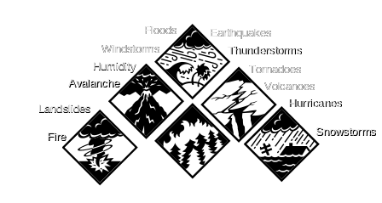
Forces of Nature
Forces of nature, force majeure, or acts of God are dangerous because they are unexpected and can occur with very little warning
Can disrupt not only the lives of individuals, but also the storage, transmission, and use of information
Include fire, flood, earthquake, and lightning as well as volcanic eruption and insect infestation
Since it is not possible to avoid many of these threats, management must implement controls to limit damage and also prepare contingency plans for continued operations
Slide <number>
Notes:
Forces of Nature
Forces of nature, force majeure, or acts of God pose the most dangerous threats, because they are unexpected and can occur with very little warning.
These threats can disrupt not only the lives of individuals, but also the storage, transmission, and use of information.
These include fire, flood, earthquake, and lightning as well as volcanic eruption and insect infestation.
Since it is not possible to avoid many of these threats, management must implement controls to limit damage and also prepare contingency plans for continued operations.

Slide 48
Deviations in Quality of Service by Service Providers
Situations of product or services not delivered as expected
Information system depends on many inter-dependent support systems
Three sets of service issues that dramatically affect the availability of information and systems are
  Internet service
  Communications
  Power irregularities
Slide <number>
Notes:
Potential Deviations in Quality of Service by Service Providers
This category represents situations in which a product or services are not delivered to the organization as expected.
The organization’s information system depends on the successful operation of many inter-dependent support systems including, power grids, telecom networks, parts suppliers, service vendors, and even the janitorial staff and garbage haulers.
Internet service, communications, and power irregularities are three sets of service issues that dramatically affect the availability of information and systems.

Slide 49
Technical Hardware Failures or Errors
Technical hardware failures or errors occur when a manufacturer distributes to users equipment containing flaws
These defects can cause the system to perform outside of expected parameters, resulting in unreliable service or lack of availability
Some errors are terminal, in that they result in the unrecoverable loss of the equipment
Some errors are intermittent, in that they only periodically manifest themselves, resulting in faults that are not easily repeated
Slide <number>
Notes:
Technical Hardware Failures or Errors
Technical hardware failures or errors occur when a manufacturer distributes to users equipment containing a known or unknown flaw.
These defects can cause the system to perform outside of expected parameters, resulting in unreliable service or lack of availability.
Some errors are terminal, in that they result in the unrecoverable loss of the equipment. Some errors are intermittent, in that they only periodically manifest themselves, resulting in faults that are not easily repeated.

Slide 50
Technical Hardware Failures or Errors
This category of threats comes from purchasing software with unrevealed faults
Large quantities of computer code are written, debugged, published, and sold only to determine that not all bugs were resolved
Sometimes, unique combinations of certain software and hardware reveal new bugs
Sometimes, these items aren’t errors, but are purposeful shortcuts left by programmers for honest or dishonest reasons
Slide <number>
Notes:
Technical Software Failures or Errors
This category of threats comes from purchasing software with unknown, hidden faults.
Large quantities of computer code are written, debugged, published, and sold only to determine that not all bugs were resolved.
Sometimes, unique combinations of certain software and hardware reveal new bugs.
Sometimes, these items aren’t errors, but are purposeful shortcuts left by programmers for honest or dishonest reasons.

Slide 51
Technological Obsolescence
When the infrastructure becomes antiquated or outdated, it leads to unreliable and untrustworthy systems
Management must recognize that when technology becomes outdated, there is a risk of loss of data integrity to threats and attacks
Ideally, proper planning by management should prevent the risks from technology obsolesce, but when obsolescence is identified, management must take action
Slide <number>
Notes:
Technological Obsolescence
When the infrastructure becomes antiquated or outdated, it leads to unreliable and untrustworthy systems.
Management must recognize that when technology becomes outdated, there is a risk of loss of data integrity to threats and attacks.
Ideally, proper planning by management should prevent the risks from technology obsolesce, but when obsolescence is identified, management must take immediate action.

Slide 52
Attacks
An attack is the deliberate act that exploits vulnerability
It is accomplished by a threat-agent to damage or steal an organization’s information or physical asset
  An exploit is a technique to compromise a system
  A vulnerability is an identified weakness of a controlled system whose controls are not present or are no longer effective
  An attack is then the use of an exploit to achieve the compromise of a controlled system
Slide <number>
Notes:
ATTACKS
An attack is the deliberate act that exploits vulnerability.
It is accomplished by a threat-agent to damage or steal an organization’s information or physical asset.
An exploit is a technique to compromise a system. Vulnerability is an identified weakness of a controlled system whose controls are not present or are no longer effective. An attack is then the use of an exploit to achieve the compromise of a controlled system.

Slide 53
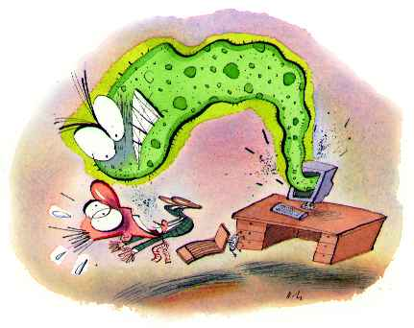
Malicious Code
This kind of attack includes the execution of viruses, worms, Trojan horses, and active web scripts with the intent to destroy or steal information
The state of the art in attacking systems in 2002 is the multi-vector worm using up to six attack vectors to exploit a variety of vulnerabilities in commonly found information system devices
Slide <number>
Notes:
The goal is to destroy or corrupt data or to shut down a network or computer system.

Slide 54
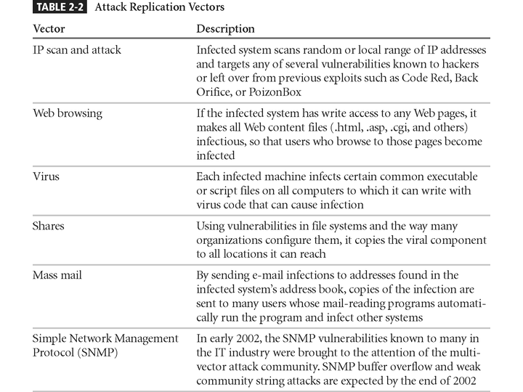
Slide <number>

Slide 55
Attack Descriptions
IP Scan and Attack – Compromised system scans random or local range of IP addresses and targets any of several vulnerabilities known to hackers or left over from previous exploits
Web Browsing - If the infected system has write access to any Web pages, it makes all Web content files infectious, so that users who browse to those pages become infected
Virus - Each infected machine infects certain common executable or script files on all computers to which it can write with virus code that can cause infection
Slide <number>
Notes:
Virus is a computer program that attaches itself to an executable file or application. It can replicate itself, usually through an executable program attached to an e-mail.
The keyword is “attaches”. A virus can not stand on its own. It cannot replicate itself or operate without the presence of a host program. A virus attaches itself to a host program, just as the flu attaches itself to a host organism. You must prevent viruses from being installed on computers in your organizations, otherwise, after the virus attaches itself to a program, such as microsoft Word, it performs whatever its creator designed it to do.

Slide 56
Attack Descriptions
Unprotected Shares - using file shares to copy viral component to all reachable locations
Mass Mail - sending e-mail infections to addresses found in address book
Simple Network Management Protocol - SNMP vulnerabilities used to compromise and infect
Hoaxes - A more devious approach to attacking computer systems is the transmission of a virus hoax, with a real virus attached
Slide <number>
Notes:
Attack Descriptions
Shares - Using vulnerabilities in file systems and the way many organizations configure them, it copies the viral component to all locations it can reach.
Mass Mail - By sending e-mail infections to addresses found in the infected systems address book, copies of the infection are sent to many users whose mail-reading programs automatically run the program and infect other systems.
Simple Network Management Protocol - In early 2002, the SNMP vulnerabilities known to many in the IT industry were brought to the attention of the multi-vector attack community.
Hoaxes - A more devious approach to attacking computer systems is the transmission of a virus hoax, with a real virus attached.

Slide 57
Attack Descriptions
Back Doors - Using a known or previously unknown and newly discovered access mechanism, an attacker can gain access to a system or network resource
Password Crack - Attempting to reverse calculate a password
Brute Force - The application of computing and network resources to try every possible combination of options of a password
Dictionary - The dictionary password attack narrows the field by selecting specific accounts to attack and uses a list of commonly used passwords (the dictionary) to guide guesses
Slide <number>
Notes:
Attack Descriptions
Back Doors - Using a known or previously unknown and newly discovered access mechanism, an attacker can gain access to a system or network resource.
Password Crack - Attempting to reverse calculate a password.
Brute Force - The application of computing and network resources to try every possible combination of options of a password.
Dictionary - The dictionary password attack narrows the field by selecting specific accounts to attack and uses a list of commonly used passwords (the dictionary) to guess with.

Slide 58
Attack Descriptions
Denial-of-service (DoS) –
  attacker sends a large number of connection or information requests to a target
  so many requests are made that the target system cannot handle them successfully along with other, legitimate requests for service
  may result in a system crash, or merely an inability to perform ordinary functions
Distributed Denial-of-service (DDoS) - an attack in which a coordinated stream of requests is launched against a target from many locations at the same time
Slide <number>
Notes:
Attack Descriptions
Denial-of-service (DoS) - the attacker sends a large number of connection or information requests to a target. So many requests are made that the target system cannot handle them successfully along with other, legitimate requests for service. This may result in a system crash, or merely an inability to perform ordinary functions.
Distributed Denial-of-service (DDoS) - an attack in which a coordinated stream of requests is launched against a target from many locations at the same time.

Slide 59
Slide <number>

Slide 60
Attack Descriptions
Spoofing - technique used to gain unauthorized access whereby the intruder sends messages to a computer with an IP address indicating that the message is coming from a trusted host
Man-in-the-Middle - an attacker sniffs packets from the network, modifies them, and inserts them back into the network
Spam - unsolicited commercial e-mail - while many consider spam a nuisance rather than an attack, it is emerging as a vector for some attacks
Slide <number>
Notes:
Attack Descriptions
Spoofing - a technique used to gain unauthorized access to computers, whereby the intruder sends messages to a computer with an IP address indicating that the message is coming from a trusted host.
Man-in-the-Middle - In the man-in-the-middle or TCP hijacking attack, an attacker sniffs packets from the network, modifies them, and inserts them back into the network.
Spam - unsolicited commercial e-mail. While many consider Spam a nuisance rather than an attack, it is emerging as a vector for some attacks.

Slide 61
Slide <number>

Slide 62
Slide <number>

Slide 63
Attack Descriptions
Mail-bombing - another form of e-mail attack that is also a DoS, in which an attacker routes large quantities of e-mail to the target
Sniffers - a program and/or device that can monitor data traveling over a network. Sniffers can be used both for legitimate network management functions and for stealing information from a network
Social Engineering - within the context of information security, the process of using social skills to convince people to reveal access credentials or other valuable information to the attacker
Slide <number>
Notes:
Attack Descriptions
Mail-bombing - Another form of e-mail attack that is also a DoS, in which an attacker routes large quantities of e-mail to the target.
Sniffers - a program and/or device that can monitor data traveling over a network. Sniffers can be used both for legitimate network management functions and for stealing information from a network.
Social Engineering - Within the context of information security, the process of using social skills to convince people to reveal access credentials or other valuable information to the attacker.

Slide 64
Attack Descriptions
“People are the weakest link. You can have the best technology; firewalls, intrusion-detection systems, biometric devices ... and somebody can call an unsuspecting employee. That's all she wrote, baby. They got everything.”
“brick attack” – the best configured firewall in the world can’t stand up to a well placed brick
Slide <number>
Notes:
Attack Descriptions
“People are the weakest link. You can have the best technology; firewalls, intrusion-detection systems, biometric devices ... and somebody can call an unsuspecting employee. That's all she wrote, baby. They got everything.”
“brick attack” – the best configured firewall in the world can’t stand up to a well placed brick.

Slide 65
Attack Descriptions
Buffer Overflow –
  application error occurs when more data is sent to a buffer than it can handle
  when the buffer overflows, the attacker can make the target system execute instructions, or the attacker can take advantage of some other unintended consequence of the failure
  Usually the attacker fill the overflow buffer with executable program code to elevate the attacker’s permission to that of an administrator.
Slide <number>
Notes:
Attack Descriptions
Buffer Overflow - an application error that occurs when more data is sent to a buffer than it can handle. When the buffer overflows, the attacker can make the target system execute instructions, or the attacker can take advantage of some other unintended consequence of the failure.
Timing Attack - relatively new, works by exploring the contents of a web browser’s cache. This could allow the designer to collect information on access to password-protected sites. Another attack by the same name involves attempting to intercept cryptographic elements to determine keys and encryption algorithms.

Slide 66
Attack Descriptions
Ping of Death Attacks --
  A type of DoS attack
  Attacker creates an ICMP packet that is larger than the maximum allowed 65,535 bytes.
  The large packet is fragmented into smaller packets and reassembled at its destination.
  Destination user cannot handle the reassembled oversized papcket, thereby causing the system to crash or freeze.
Slide <number>

Slide 67
Attack Descriptions
Timing Attack –
  relatively new
  works by exploring the contents of a web browser’s cache
  can allow collection of information on access to password-protected sites
  another attack by the same name involves attempting to intercept cryptographic elements to determine keys and encryption algorithms
Slide <number>
Notes:
Attack Descriptions
Buffer Overflow - an application error that occurs when more data is sent to a buffer than it can handle. When the buffer overflows, the attacker can make the target system execute instructions, or the attacker can take advantage of some other unintended consequence of the failure.
Timing Attack - relatively new, works by exploring the contents of a web browser’s cache. This could allow the designer to collect information on access to password-protected sites. Another attack by the same name involves attempting to intercept cryptographic elements to determine keys and encryption algorithms.

